Slide 1
Noise2Void demo

Slide 2
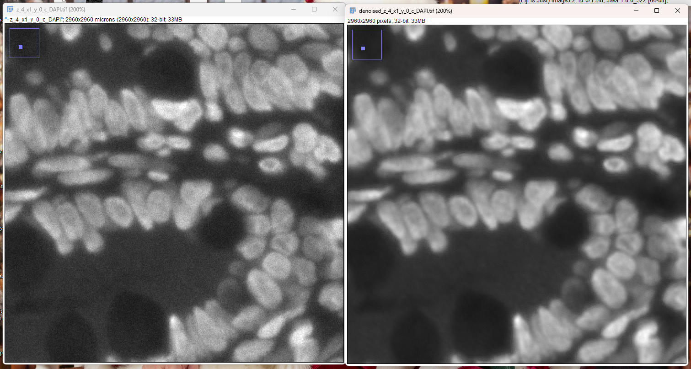
DAPI

Slide 3
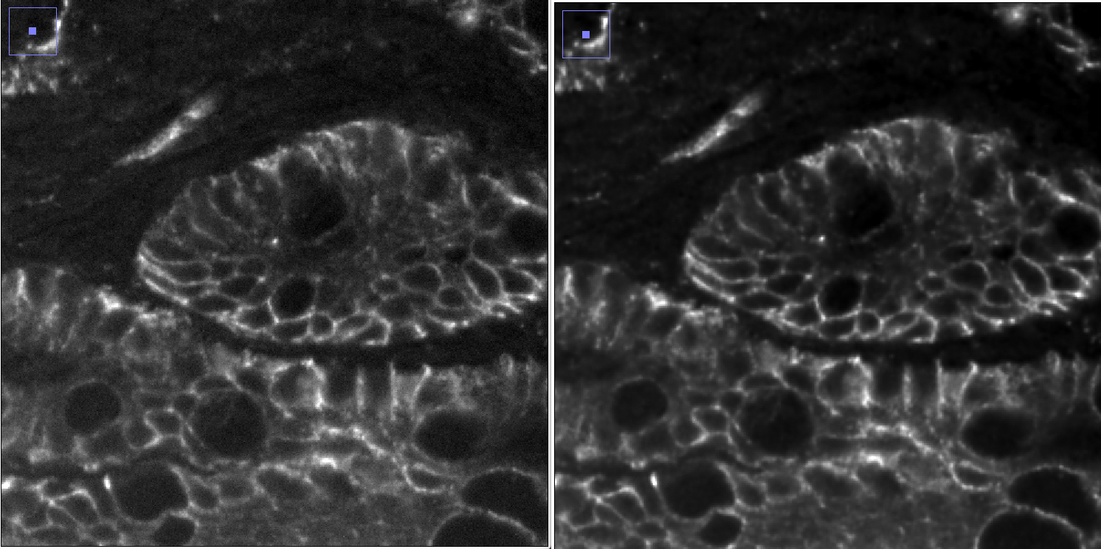
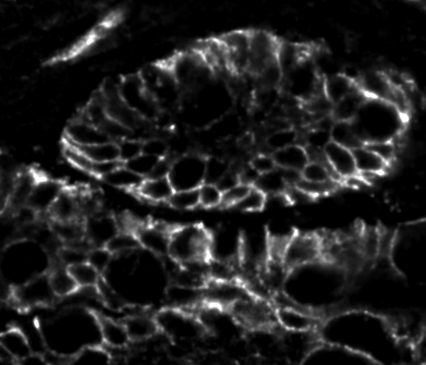
EPCAM
Raw
N2V
N2V + Rolling Ball

Slide 4
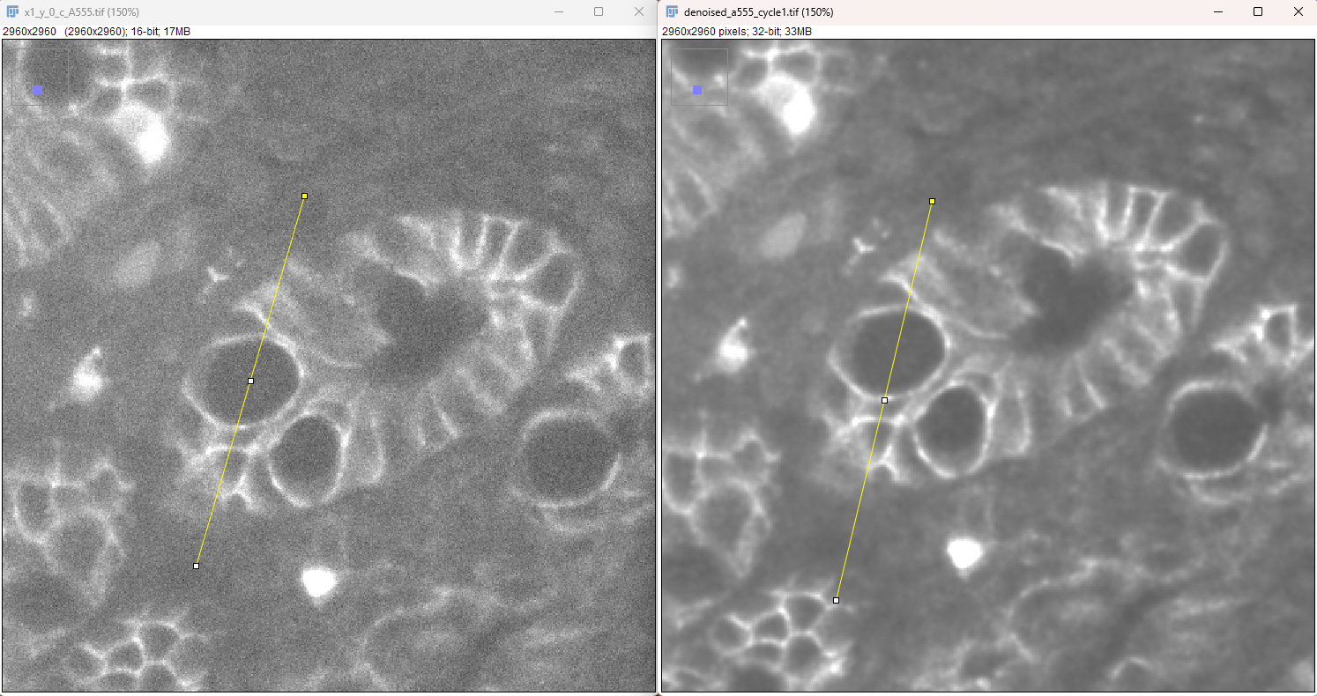

A555_cycle1

